Slide 1
Advance Java
Lecture 2

Slide 2
Agenda
Handling HTTP request and response –GET /POST method
Servlet Collaboration
Session tracking
Using cookies

Slide 3
Handling HTTP request and response –GET /POST method
Of the six doxxx methods, the doPost and the doGet methods are the most frequently used.
The doPost method is called when the browser sends an HTTP request using the POST method.
The POST method is one of the two methods that can be used by an HTML form. Consider the following HTML form at the client side:
<FORM ACTION="Register" METHOD="POST">
<INPUT TYPE=TEXT Name="firstName">
<INPUT TYPE=TEXT Name="lastName">
<INPUT TYPE=SUBMIT>
</FORM>

Slide 4
Handling HTTP request and response –GET /POST method
You may wonder how a servlet knows what doxxx method to invoke.
You can find the answer by reading the source code of the HttpServlet class. This class inherits the service method from the javax.servlet.Servlet interface that gets called by the servlet container.
Remember that its signature is as follows:
public void service(ServletRequest request, ServletResponse response) throws ServletException, IOException
The method tries to downcast request to HttpRequest and response to HttpResponse, and pass both as arguments to the second service method that has the following signature:
protected void service(HttpServletRequest request, HttpServletResponse response) throws ServletException, IOException
The HttpServletRequest interface has a method named getMethod that returns a String containing the HTTP method used by the client request. Knowing the HTTP method, the service method simply calls the corresponding doxxx method.

Slide 5
doGet()
public void doGet(HttpServletRequest request, HttpServletResponse response) throws ServletException, IOException { String var0show = ""; try { var0show = request.getParameter("showthis"); } catch(Exception e) { e.printStackTrace(); } response.setContentType(CONTENT_TYPE); PrintWriter out = response.getWriter(); out.println("<html>"); out.println("<head><title>demolet</title></head>"); out.println("<body>"); out.println("<p>The servlet has received a GET. This is the reply.</p>"); out.println("</body></html>"); out.close(); }

Slide 6
doPost()
public void doPost(HttpServletRequest request, HttpServletResponse response) throws ServletException, IOException { String var0show = ""; try { var0show = request.getParameter("showthis"); } catch(Exception e) { e.printStackTrace(); } response.setContentType(CONTENT_TYPE); PrintWriter out = response.getWriter(); out.println("<html>"); out.println("<head><title>demolet</title></head>"); out.println("<body>"); out.println("<p>The servlet has received a POST. This is the reply.</p>"); out.println("</body></html>"); out.close(); } }

Slide 7
Servlet Collaboration
In some circumstances, you may want to include the content from an HTML page or the output from another servlet.
Additionally, there are cases that require that you pass the processing of an HTTP request from your servlet to another servlet.
The current servlet specification responds to these needs with an interface called RequestDispatcher, which is found in the javax.servlet package.
This interface has two methods, which allow you to delegate the request-response processing to another resource: include and forward. Both methods accept a javax.servlet.ServletRequest object and javax.servlet.ServletResponse object as arguments.

Slide 8
Servlet Collaboration
As the name implies, the include method is used to include content from another resource, such as another servlet, a JSP page, or an HTML page.
The method has the following signature:
public void include(javax.servlet.ServletRequest request, javax.servlet.ServletResponse response) throws javax.servlet.ServletException, java.io.IOException
The forward method is used to forward a request from one servlet to another. The original servlet can perform some initial tasks on the ServletRequest object before forwarding it. The signature of the forward method is as follows:
public void forward(javax.servlet.ServletRequest request, javax.servlet.ServletResponse response) throws javax.servlet.ServletException, java.io.IOException

Slide 9
Servlet Collaboration
To perform a servlet include or forward, you first need to obtain a RequestDispatcher object. You can obtain a RequestDispatcher object three different ways, as follows:
Use the getRequestDispatcher method of the javax.servlet.ServletContext interface, passing a String containing the path to the other resource. The path is relative to the root of the ServletContext.
Use the getRequestDispatcher method of the javax.servlet.ServletRequest interface, passing a String containing the path to the other resource. The path is relative to the current HTTP request.
Use the getNamedDispatcher method of the javax.servlet.ServletContext interface, passing a String containing the name of the other resource.

Slide 10
Servlet Collaboration
When programmers new to servlet programming are writing code for request dispatching, they often make the common mistake of passing an incorrect path to the getRequestDispatcher method.
A big difference exists between the getRequestDispatcher method of the ServletContext interface and that belonging to the ServletRequest interface. The one you use depends on the location of the resource to be included or forwarded to.
If you use the getRequestDispatcher method of the javax.servlet.ServletContext interface, you pass a path that is relative to the root of the ServletContext.
If you use the getRequestDispatcher method of the javax.servlet.ServletRequest interface, you pass a path that is relative to the current HTTP request.

Slide 11
Servlet Collaboration
public void doGet(HttpServletRequest request, HttpServletResponse response) throws ServletException, IOException
{
RequestDispatcher rd = request.getRequestDispatcher("SecondServlet");
rd.include(request, response);
}

Slide 12
Servlet Collaboration
public void doGet(HttpServletRequest request, HttpServletResponse response) throws ServletException, IOException
{
RequestDispatcher rd =
request.getRequestDispatcher("SecondServlet");
rd.forward(request, response);
}

Slide 13
Session Tracking
The HttpSession object is used for session management. A session contains information specific to a particular user across the whole application. When a user enters into a website (or an online application) for the first time HttpSession is obtained via request.getSession(), the user is given a unique ID to identify his session. This unique ID can be stored into a cookie or in a request parameter.
The HttpSession stays alive until it has not been used for more than the timeout value specified in tag in deployment descriptor file( web.xml). The default timeout value is 30 minutes, this is used if you don’t specify the value in tag. This means that when the user doesn’t visit web application time specified, the session is destroyed by servlet container. The subsequent request will not be served from this session anymore, the servlet container will create a new session.

Slide 14
Session Tracking
This is how you create a HttpSession object.
protected void doPost(HttpServletRequest req, HttpServletResponse res) throws ServletException, IOException {
HttpSession session = req.getSession();
}

Slide 15
Session Tracking
You can store the user information into the session object by using setAttribute() method and later when needed this information can be fetched from the session. This is how you store info in session. Here we are storing username, emailid and userage in session with the attribute name uName, uemailId and uAge respectively.
session.setAttribute("uName", “John"); session.setAttribute("uemailId", “john@gmail.com"); session.setAttribute("uAge", "30");
The First parameter is the attribute name and second is the attribute value.

Slide 16
Session Tracking
TO get the value from session we use the getAttribute() method of HttpSession interface. Here we are fetching the attribute values using attribute names.
String userName = (String) session.getAttribute("uName");
String userEmailId = (String) session.getAttribute("uemailId"); String userAge = (String) session.getAttribute("uAge");

Slide 17
Session Tracking
public void setAttribute(String name, Object value): Binds the object with a name and stores the name/value pair as an attribute of the HttpSession object. If an attribute already exists, then this method replaces the existing attributes.
public Object getAttribute(String name): Returns the String object specified in the parameter, from the session object. If no object is found for the specified attribute, then the getAttribute() method returns null.
public Enumeration getAttributeNames(): Returns an Enumeration that contains the name of all the objects that are bound as attributes to the session object.
public void removeAttribute(String name): Removes the given attribute from session.
setMaxInactiveInterval(int interval): Sets the session inactivity time in seconds. This is the time in seconds that specifies how long a sessions remains active since last request received from client.

Slide 18
Using Cookies
Cookies are text files stored on the client computer and they are kept for various information tracking purpose. Java Servlets transparently supports HTTP cookies.
There are three steps involved in identifying returning users −
Server script sends a set of cookies to the browser. For example name, age, or identification number etc.
Browser stores this information on local machine for future use.
When next time browser sends any request to web server then it sends those cookies information to the server and server uses that information to identify the user.

Slide 19
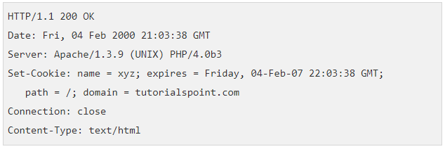
The Anatomy of a Cookie
Cookies are usually set in an HTTP header (although JavaScript can also set a cookie directly on a browser).
If the browser is configured to store cookies, it will then keep this information until the expiry date.
A servlet that sets a cookie might send headers that look something like this −

Slide 20
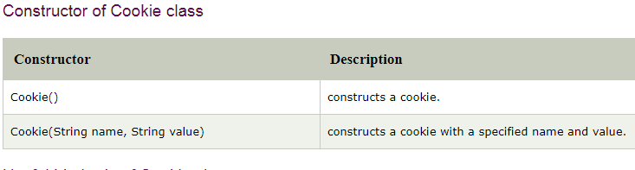
Cookie
javax.servlet.http.Cookie class provides the functionality of using cookies. It provides a lot of useful methods for cookies.

Slide 21
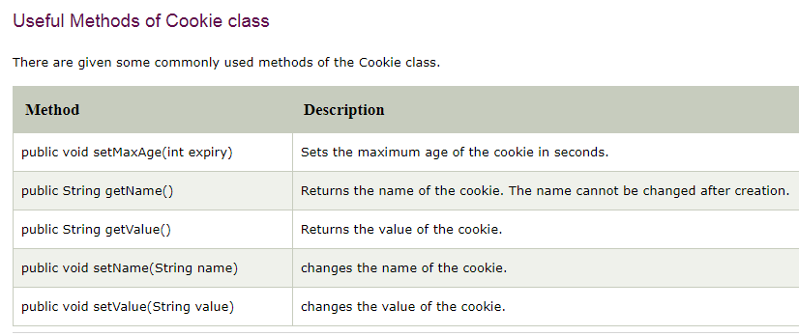
Cookie

Slide 22
Using Cookies Example
<form action="servlet1" method="post">
Name:<input type="text" name="userName"/><br/>
<input type="submit" value="go"/>
</form>

Slide 23
Using Cookies Example
public class FirstServlet extends HttpServlet {
public void doPost(HttpServletRequest request, HttpServletResponse response){
try{
response.setContentType("text/html");
PrintWriter out = response.getWriter();
String n=request.getParameter("userName");
out.print("Welcome "+n);
Cookie ck=new Cookie("uname",n);//creating cookie object
response.addCookie(ck);//adding cookie in the response
//creating submit button
out.print("<form action='servlet2'>");
out.print("<input type='submit' value='go'>");
out.print("</form>");
out.close();
}catch(Exception e){System.out.println(e);}
}
}

Slide 24
Using Cookies Example
public class SecondServlet extends HttpServlet {
public void doPost(HttpServletRequest request, HttpServletResponse response){
try{
response.setContentType("text/html");
PrintWriter out = response.getWriter();
Cookie ck[]=request.getCookies();
out.print("Hello "+ck[0].getValue());
out.close();
}catch(Exception e){System.out.println(e);}
}
}

Slide 25
Cookies Example- set expiry
// Create cookies for first and last names.
Cookie firstName = new Cookie("first_name", request.getParameter("first_name"));
Cookie lastName = new Cookie("last_name", request.getParameter("last_name"));
// Set expiry date after 24 Hrs for both the cookies. firstName.setMaxAge(60*60*24);
lastName.setMaxAge(60*60*24);
// Add both the cookies in the response header. response.addCookie( firstName );
response.addCookie( lastName );

Slide 26
Fetching all cookies
Cookie cookie = null;
Cookie[] cookies = null;
// Get an array of Cookies associated with this domain cookies = request.getCookies();
if( cookies != null ) {
out.println("<h2> Found Cookies Name and Value</h2>");
for (int i = 0; i < cookies.length; i++)
{
cookie = cookies[i];
out.print("Name : " + cookie.getName( ) + ", ");
out.print("Value: " + cookie.getValue( ) + " <br/>");
}
} else
{
out.println("<h2>No cookies founds</h2>");
}

Slide 27
Delete Cookie
To delete cookies is very simple. If you want to delete a cookie then you simply need to follow up following three steps −
Read an already existing cookie and store it in Cookie object.
Set cookie age as zero using setMaxAge() method to delete an existing cookie
Add this cookie back into response header.
if((cookie.getName( )).compareTo("first_name") == 0 )
{
cookie.setMaxAge(0);
response.addCookie(cookie);
}

Slide 28
Thank You

